Slide 1
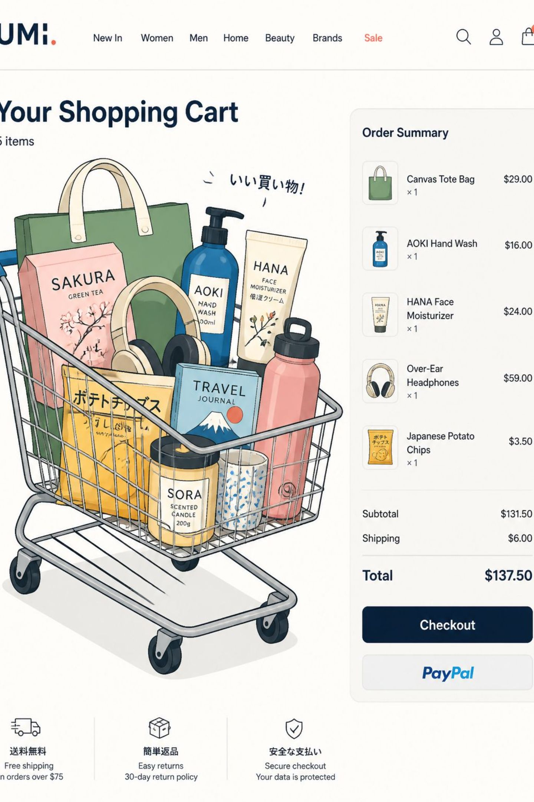
Customer Shopping Behavior Analysis
3,900 purchases • 18 features • Aim: uncover spending patterns, segments, product & subscription insights

Slide 2
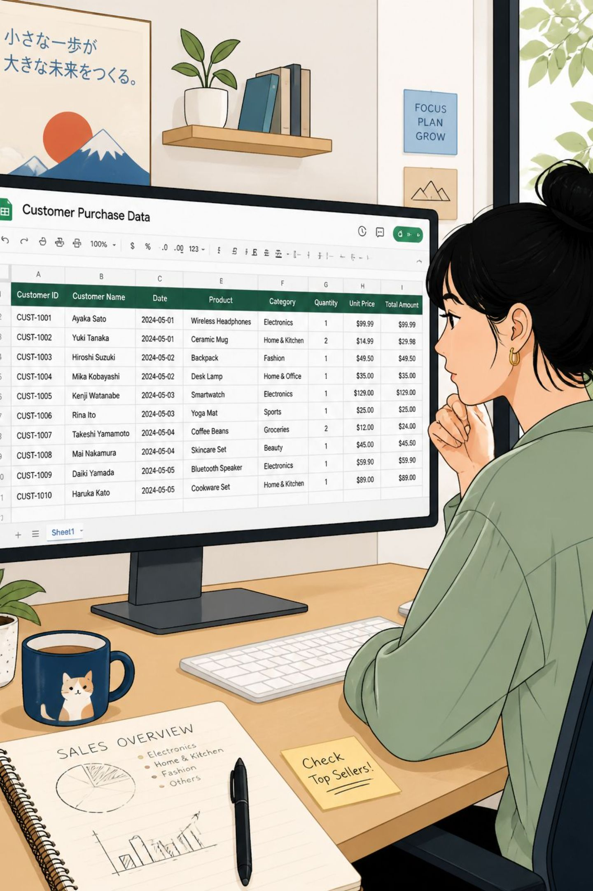
Dataset Snapshot
Rows / Columns
3,900 rows • 18 columns
Key Features
Demographics, Purchase details, Behavior flags
Missing Data
37 values in Review Rating
Avg Purchase
$59.76

Slide 3
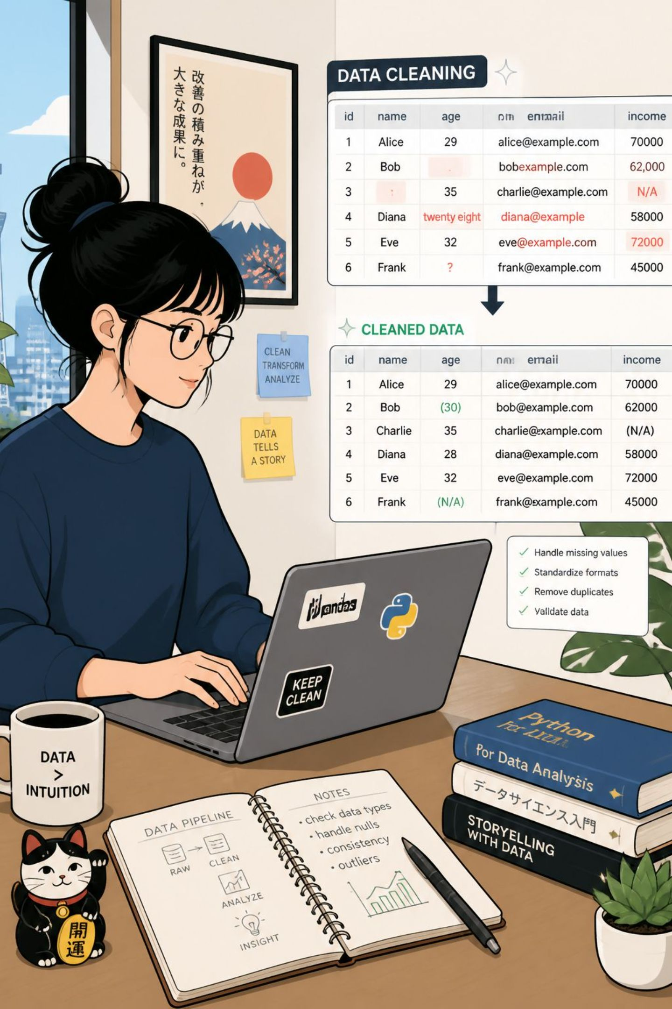
Data Prep & Cleaning (Python)
01
Load & Inspect
pandas: df.info(), .describe()
02
Impute Missing
Review Rating → median per product category
03
Standardize
Rename columns to snake_case
04
Feature Eng.
age_grouped, purchase_frequency_days

Slide 4
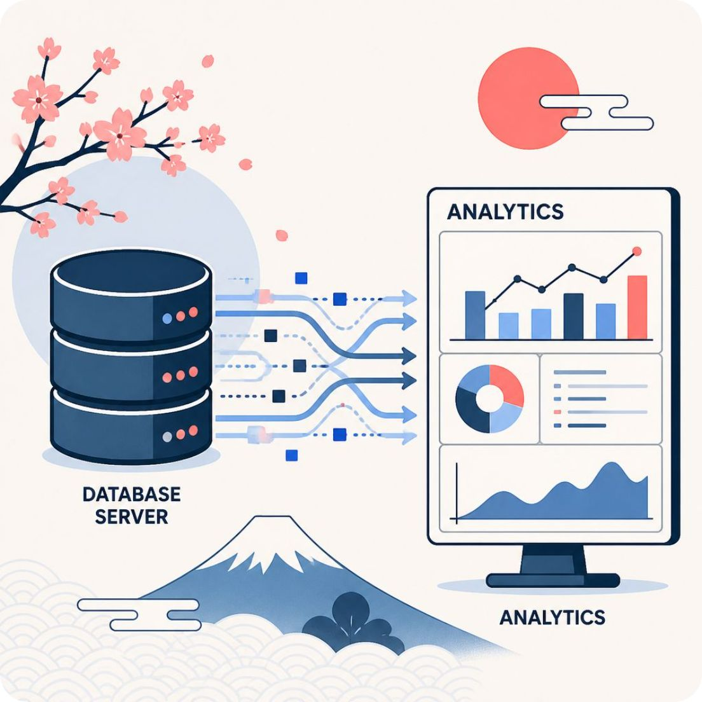
Database Integration & SQL
Workflow
Cleaned DataFrame → PostgreSQL for SQL analysis
Actions
Dropped redundant promo_code_used
Verified discount_applied consistency

Slide 5
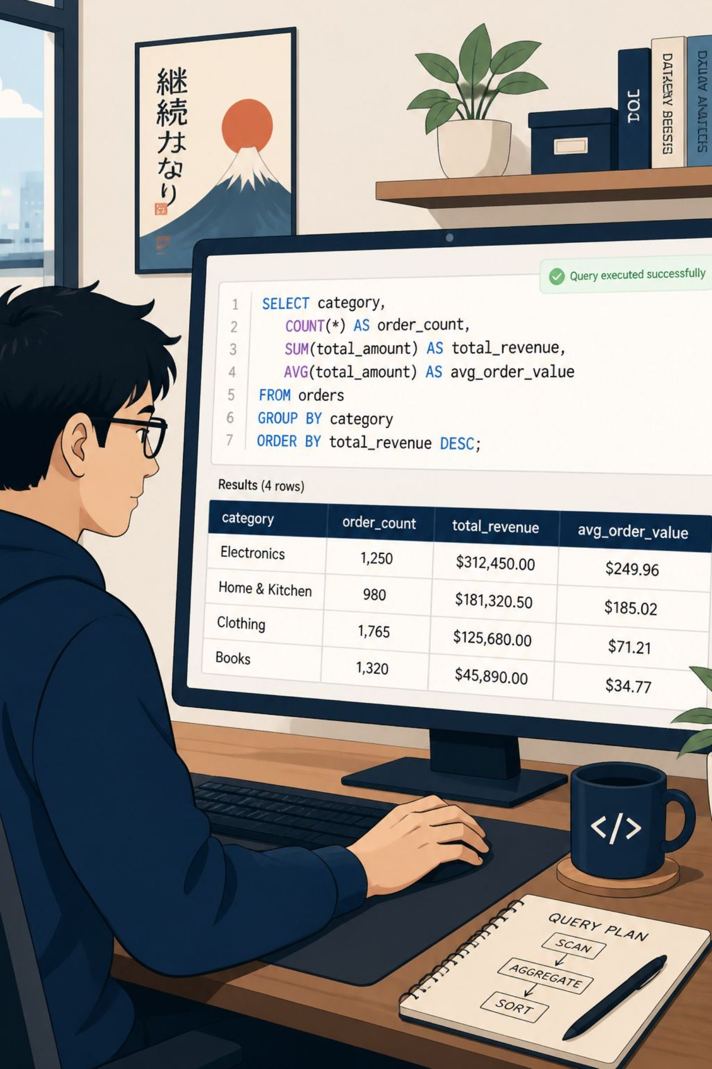
High-level SQL Findings
Revenue by Gender
Male: 157,890 • Female: 75,191
High-Spend Discount Users
Identified customers spending > average while using discounts
Top Rated Items
Gloves, Sandals, Boots, Hat, Skirt (top avg ratings)

Slide 6
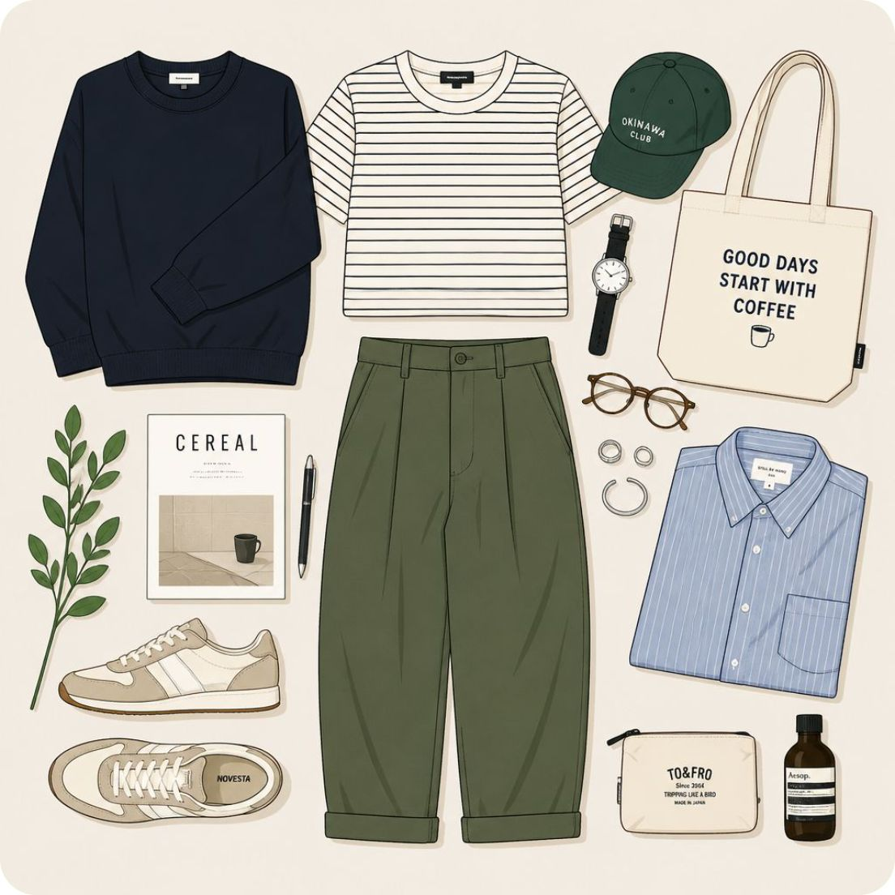
Product & Category Insights
Sales by Category
Clothing: 1,737 • Accessories: 1,240 • Footwear: 599 • Outerwear: 324
Revenue by Category
Clothing: $104K • Accessories: $74K • Footwear: $36K • Outerwear: $19K

Slide 7
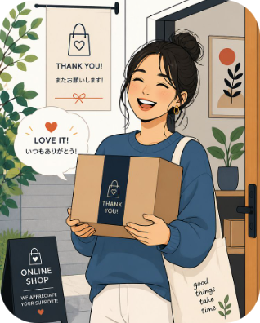
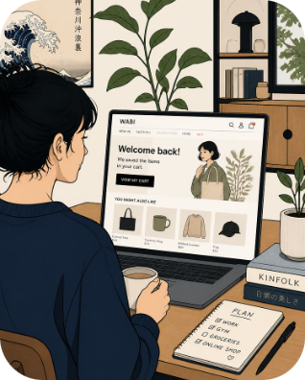
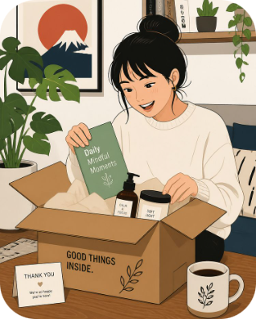
Customer Segments & Behavior
Loyal
Returning
New
3,116 customers — largest segment
701 customers
83 customers
Subscription split: Yes 27% • No 73%

Slide 8
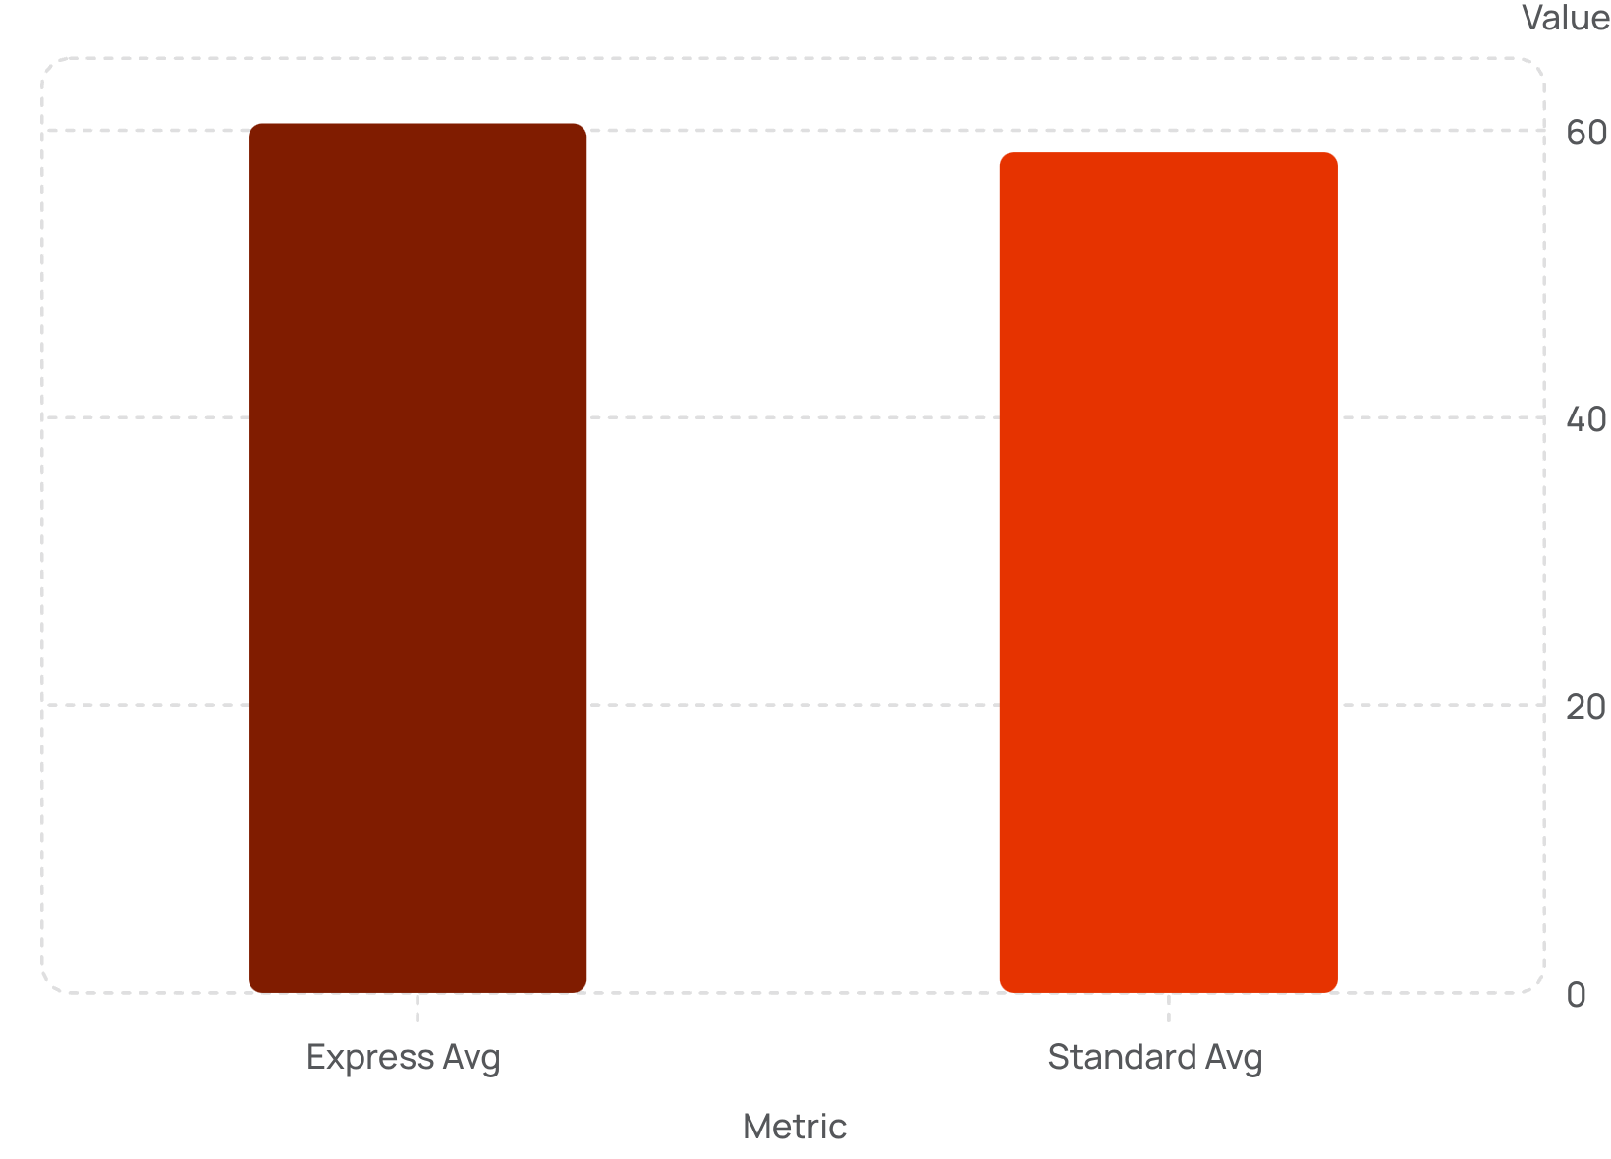
Behavioral Comparisons
Shipping Impact
Express users spend marginally more than Standard
Repeat Buyers & Subscriptions
Repeat buyers (>5 purchases): more likely to subscribe (958 yes vs 2,518 no)

Slide 9
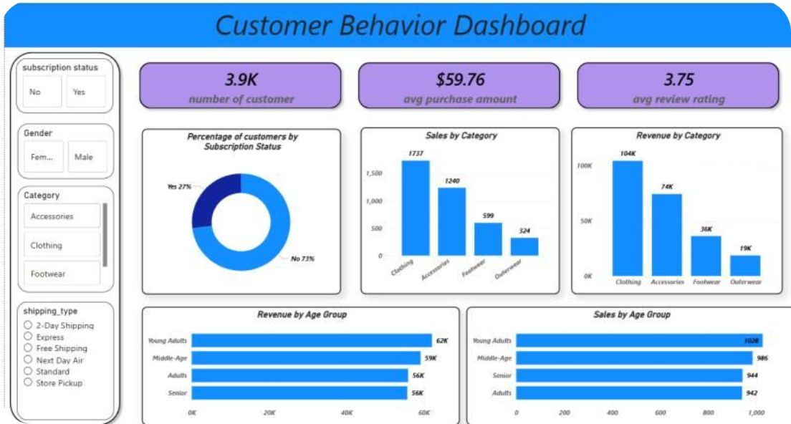
Dashboard Snapshot
Key Metrics
3.9K customers • $59.76 avg purchase • 3.75 avg review rating
Age & Revenue
Young Adults $62K • Middle‑Age $59K • Adults $56K • Senior $56K

Slide 10
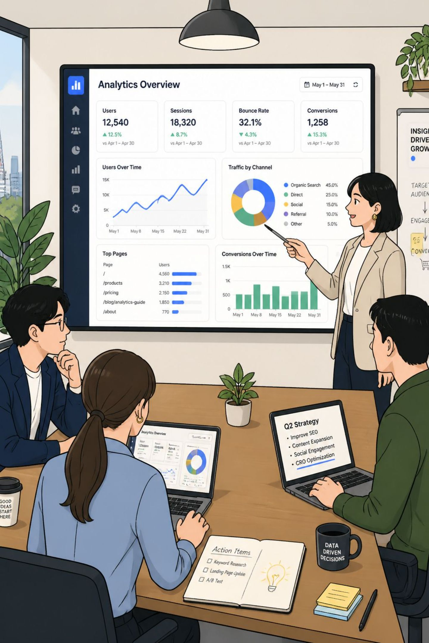
Recommendations & Conclusion
Boost Subscriptions
Promote exclusive subscriber benefits
Loyalty Programs
Reward repeat buyers to increase retention
Discount Policy
Review discounts to protect margins while driving sales
Targeted Marketing
Focus on high‑revenue age groups and express-shipping users

Slide 11


Official Sources
https://github.com/abhijitbhoi45-sketch/customer_behavior_analysis
www.linkedin.com/in/

